Slide 1
Final Project
Mayur Santani
Animesh Gandhi

Slide 2
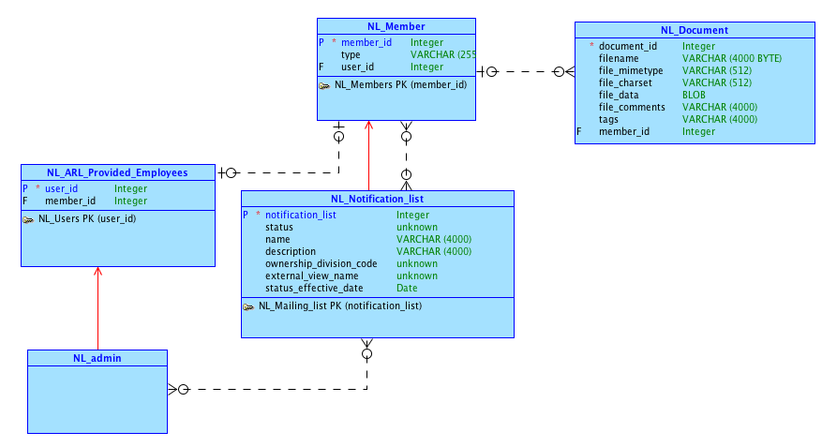
Conceptual Model

Slide 3
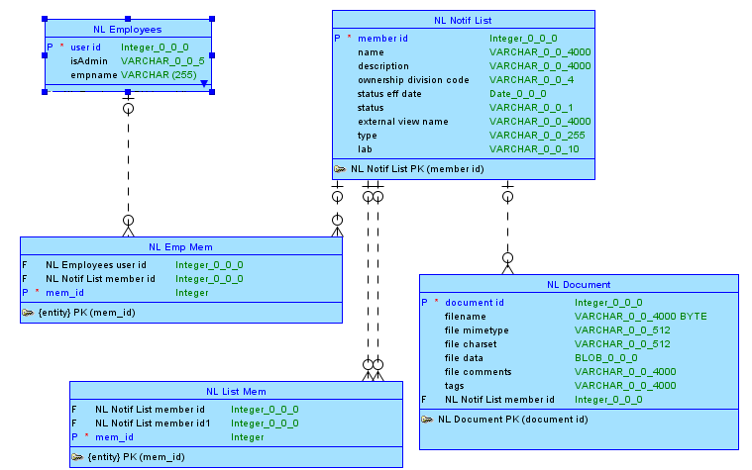
Logical Model

Slide 4
Salient Features

Slide 5
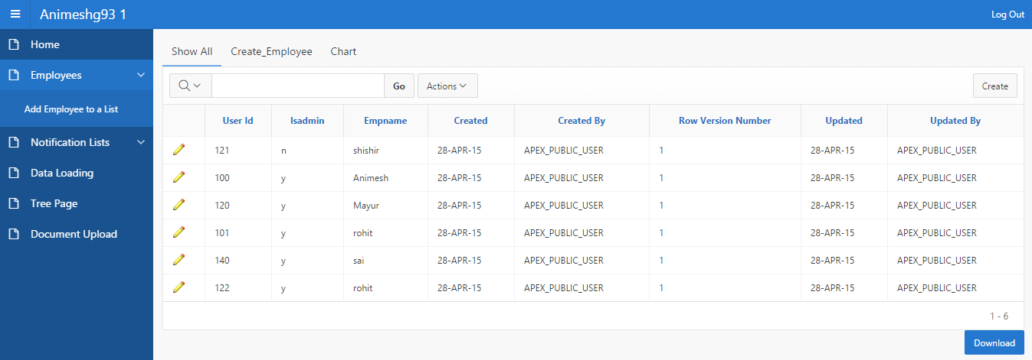
Overview of Employees

Slide 6
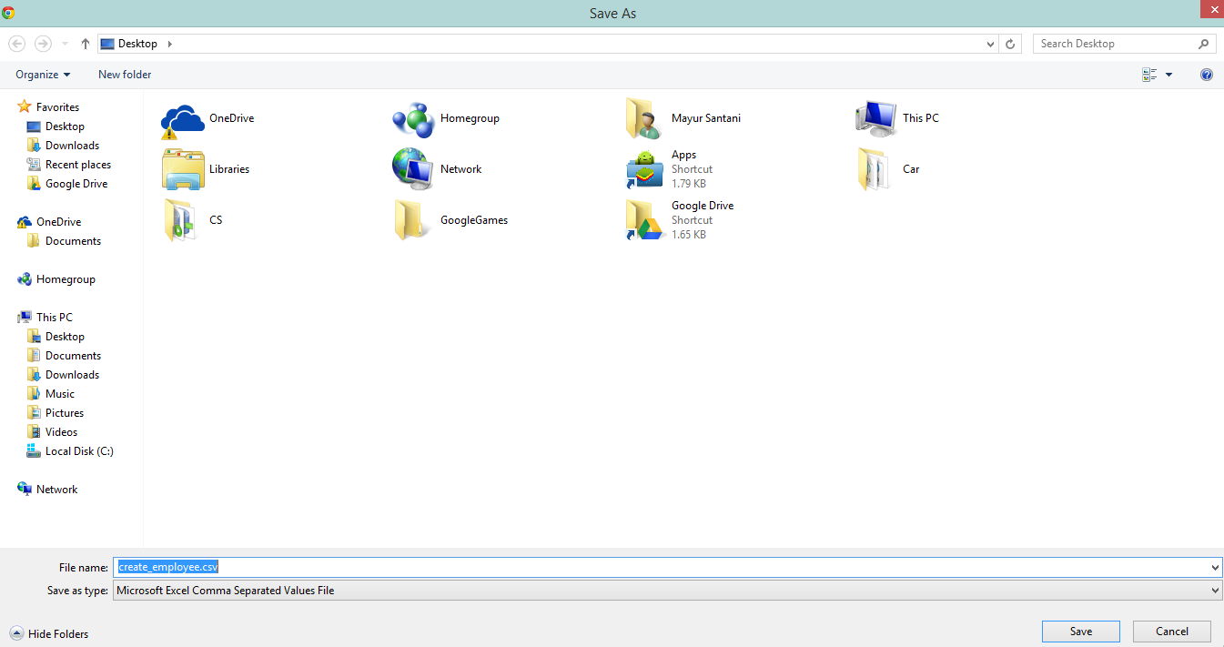
The Download button

Slide 7
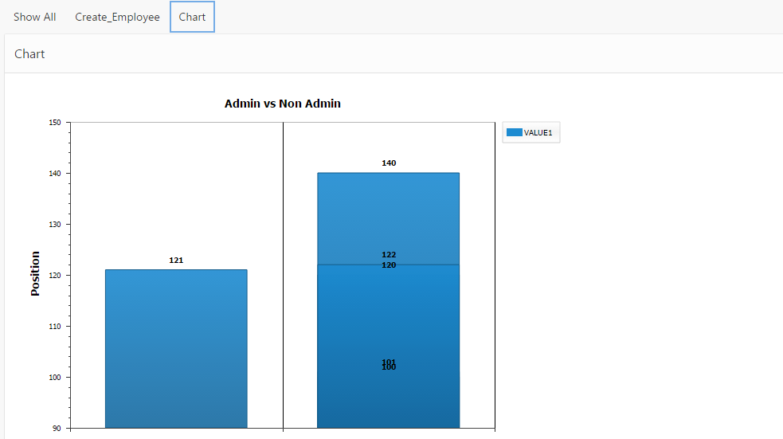
Region Display Selector

Slide 8
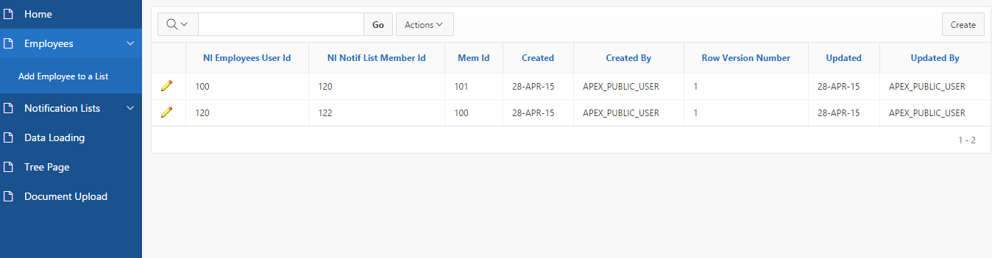
Employee to List mapping

Slide 9
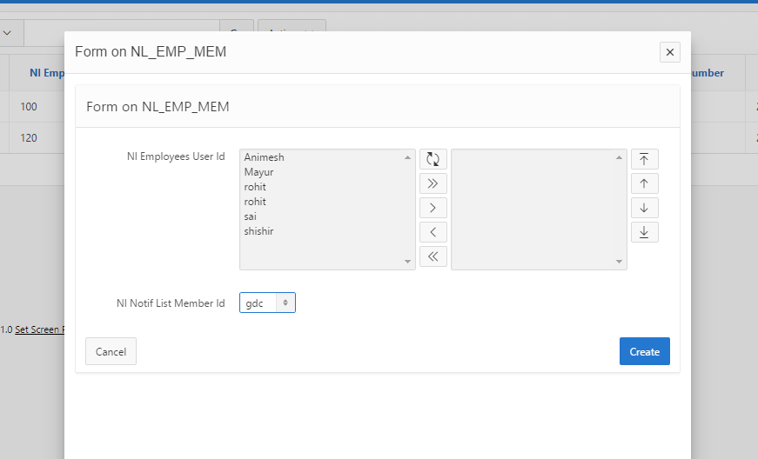
Adding Employees to a List

Slide 10
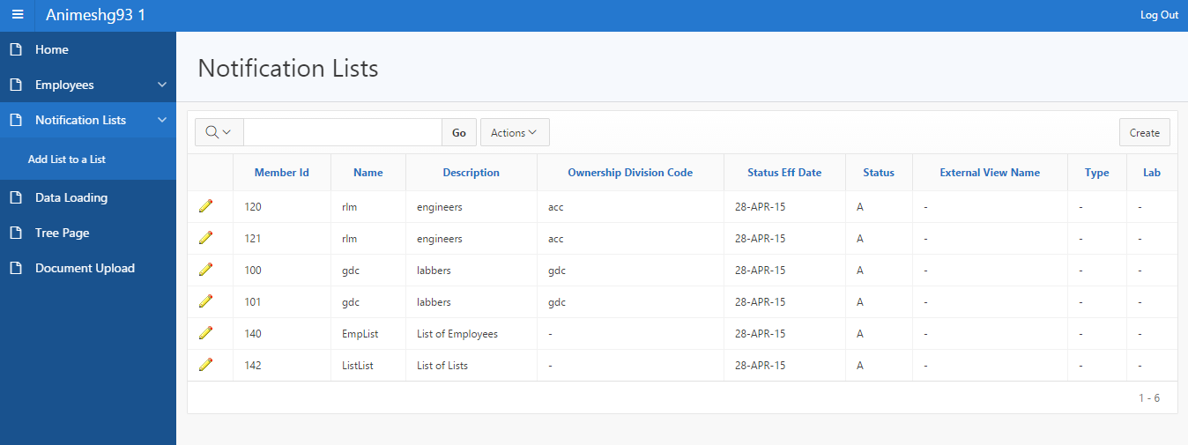
All the Notification Lists

Slide 11
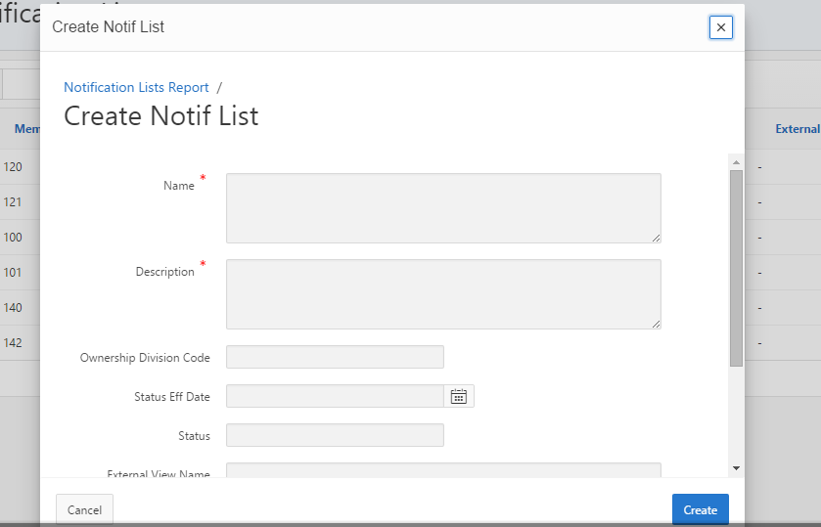
Creating a New List

Slide 12
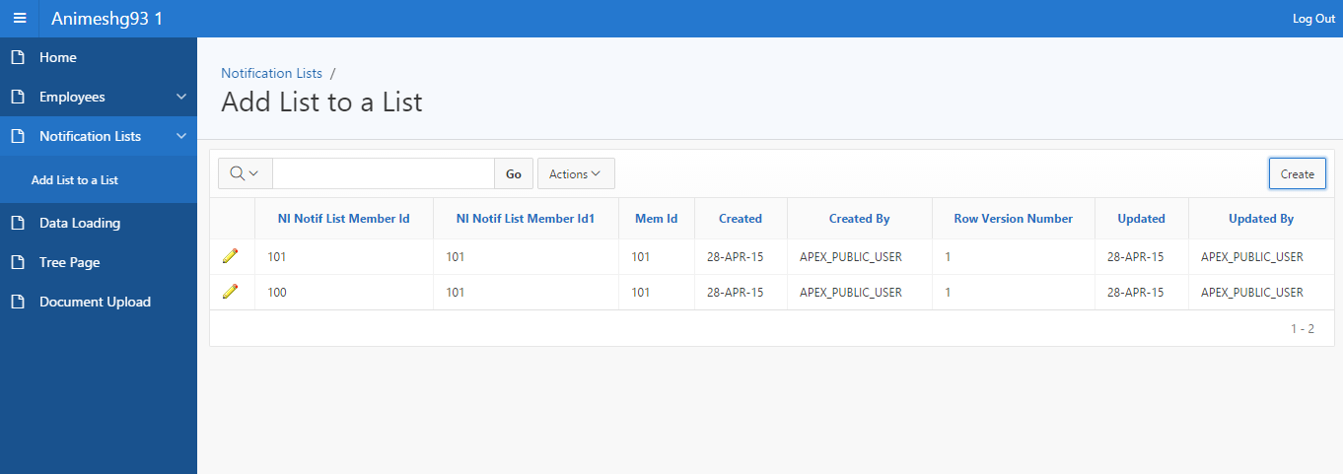
List of Lists

Slide 13
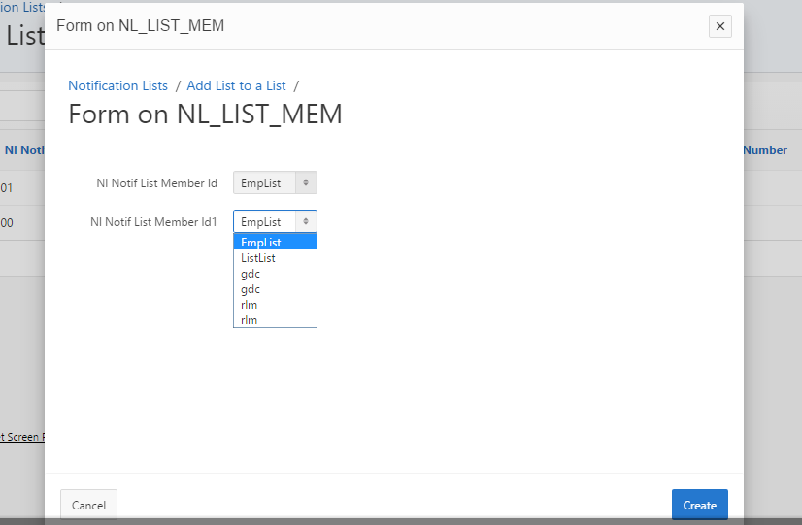
Adding a list to a List

Slide 14
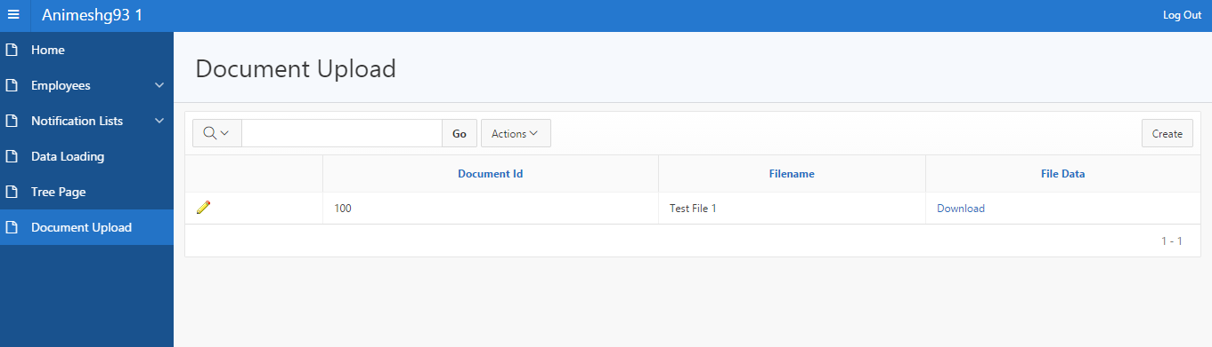
Document Upload

Slide 15
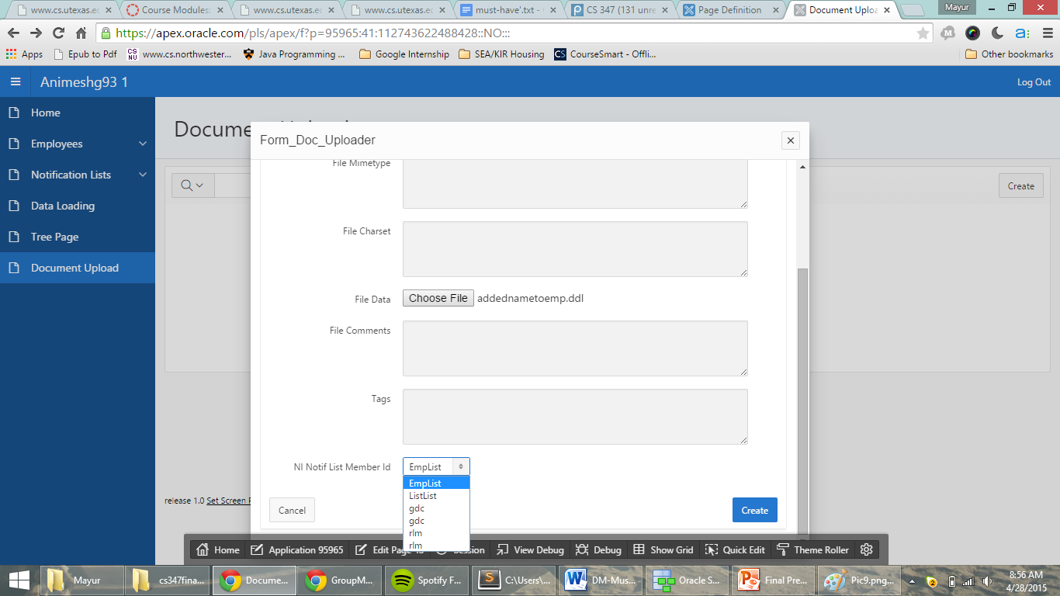
Document Uploader

Slide 16
And now its time for a demo
https://apex.oracle.com/pls/apex/f?p=95965:1:3860349066582:::::

